Slide 1
Project 3
Parkinson’s Disease Voice Data
Eric Hansen
Flatiron dS; self paced
3/16/2022

Slide 2
Background - Problem
Parkinson’s Disease affects seven million people globally; voice features are used for diagnosis, but can they be used more effectively?

Slide 3
Background - Stakeholders
Medical professionals, Patients With Parkinson’s (PWP), aging adults

Slide 4
Background – Data
'Collection and Analysis of a Parkinson Speech Dataset with Multiple Types of Sound Recordings', IEEE Journal of Biomedical and Health Informatics, vol. 17(4), pp. 828-834, 2013. https://archive.ics.uci.edu/ml/datasets/Parkinson+Speech+Dataset+with++Multiple+Types+of+Sound+Recordings#

Slide 5
Model
Eight non-linear classification tools, including logistic regression, k-nearest neighbors, random forest, bagging, gradient boosting and more

Slide 6
Goals
Goals
Identify actionable features of voice samples that may predict Parkinson’s to augment existing diagnosis tools
Create optimized model for classification of new voice data

Slide 7
Methodology Details
1) I performed Exploratory Data Analysis to identify characteristics of the data
2) I created several new features based on investigation of PD and discussion with geriatric speech pathologist, including monotonicity, oral festination, projected gender
3) I created numerous models and optimized their parameters for best accuracy (generally desirable) and recall score (due to priority of avoiding false negatives for PD) across cross validation
4) I tested each of these models on the test set
5) I identified a model which scored highly on the training and test set and extracted meaningful important features
6) I created a pipeline and pickled it for portability and ease of future use
7) The conclusions: XGBoost model had high accuracy and recall; it assigned high feature importance to some jitter and pitch features
8) Furthermore, the model is ready to accept any new voice data, to aid in diagnosis

Slide 8


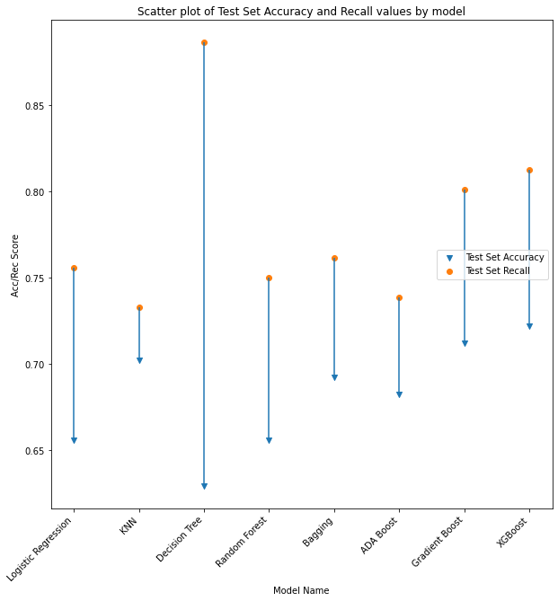
Results 1 – Test Set Accuracy&Recall By Model
Multiple crossvalidation rounds were taken for each model, average accuracy and recall were computed across these rounds; then tuned models tested on the test set
One model which did well on both was XGBoost, which had 72% accuracy and 81% recall
Other models and scores(acc, rec) are:
logistic regression: 66%, 76%
knn: 70%, 73%
decision tree: 63%, 89%
random forest: 66%, 75%
bagging: 69%, 76%
adaboost: 68%, 74%
gradientboost: 71%, 80%

Slide 9
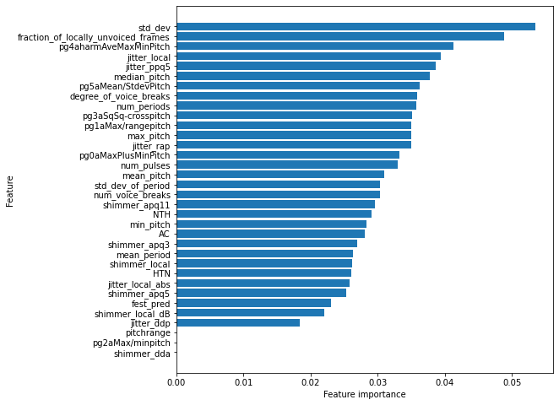
Results 2 – Feature Importances for model
The top 10 features of highest importance are:
Standard deviation of pitch
Fraction of locally unvoiced frames
Pg4 (harmonic avg of max/min pitch)*
Jitter_local
Jitter_ppq5
Median_pitch
Pg5(mean/stddev of pitch)*
Degree of voice breaks
Number of periods
Pg3 (maxpitch^2+minpitch^2-2maxp*minp)*
* These features were manually engineered

Slide 10
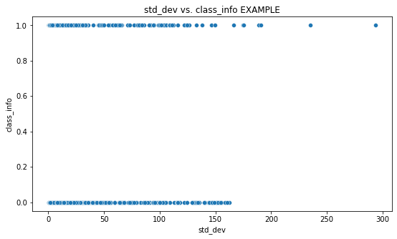
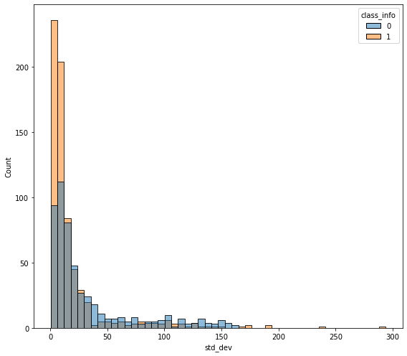
Std_dev Further inspection
Class 0 = Non PD, Class 1 = Patient with PD
It is challenging to visually identify relationships between a numeric predictor and a binary target variable, as seen in the top graph.
But we can observe some separation in behavior of the two classes in the bottom histogram – patients without PD appear to have more standard deviation of pitch – i.e. this may be consistent with less monotonicity

Slide 11
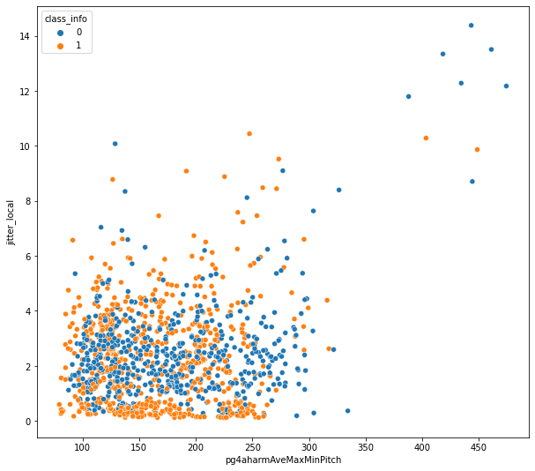
Two feature separation
If we try to separate behavior by not just one predictor, but two, and color code by target variable, we can get a little more visual insight.
Some combinations of important features show more separation, some show less – one example of illustrative graph is shown
In this case, we can see that Patients with Parkinsons (class1) frequently have very low, and occasionally higher than usual jitter_local

Slide 12
Conclusions/questions
A XGBoost model has identified some characteristics to dial in on.
As stated earlier, the top 5 features are Standard deviation of pitch, Fraction of locally unvoiced frames, Pg4 (harmonic avg of max/min pitch), Jitter local, Jitter ppq5
This model had a test set accuracy of 72% and recall of 81%

Slide 13
Conclusions/questions
Actionable items:
Prioritize identifying speech pathologies that correspond to pitch standard deviation, fraction of unvoiced frames, and jitter.
Use XGBoost or other model to add layer of additional screening to PD evaluations

Slide 14
Conclusions/questions
Potential further steps:
acquire more labeled data to further train models.
Perform study over time to identify early-changing features that predict eventual PD.

Slide 15
Conclusions/questions
Questions?

